Slide 1
Modular Distributed Ammonia Electrosynthesis
in India
Hunter Violette and Riley Barth

Slide 2
Modularly Distributed Design
Scalability: Modular plants can easily adjust capacity by adding or removing modules in response to demand changes.
Reduced Capital Investment: Modular construction requires lower initial investment due to off-site fabrication and simplified construction.
Faster Deployment: Modules can be constructed concurrently, speeding up overall project timelines.
Improved Safety: Modular construction minimizes on-site hazards and incorporates standardized safety features.
Flexibility: Modular plants can be reconfigured for different processes or products as needed.
Reliability and Redundancy: Redundant modules ensure continuous operation and reduce downtime risk.
Localized Production: Modules can be located closer to raw materials or markets, reducing transportation costs and risks.

Slide 3
Importance of Ammonia Synthesis
Fertilizer Applications (in year 2010):
157 million metric tons produced
Between 75-95% ammonia converted into fertilizers
50% of the world's population relies on synthetic ammonia fertilizer
Hydrogen Storage
Ammonia is 17.6% hydrogen by weight. One of the highest-density hydrogen carriers
Stored safely at nearly ambient conditions
Hydrogen is a promising high-energy-density clean energy carrier
Water Treatment:
Drinking water: purge nitrates and organic compounds
Waste water: Control pH and remove impurities through precipitation, ion exchange

Slide 4
Importance of Ammonia Synthesis cont.
Textile Industry: Used for dyeing, printing, and finishing processes of textiles
Pharmaceuticals: Ammonia and its derivatives are constantly used in the pharmaceutical industry for pH adjustments and organic chemistry reactions
Industrial Refrigerant: Excellent thermodynamic properties with zero ozone depletion
Cleaning and Sanitization: Used in household and industrial cleaning/sanitization
Explosives: Ammonium-nitrate is a commonly used ingredient in the manufacturing of explosives and explosive mixtures.

Slide 5
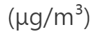


Why India?
Country | World Population Rank | Population (millions) | 2023 PM2.5 Concentration | World Pollution Rank
India | 1 | 1,428 | 54.4 | 3
China | 2 | 1,425 | 32.5 | 19
United States | 3 | 339 | 9.1 | 102

Slide 6
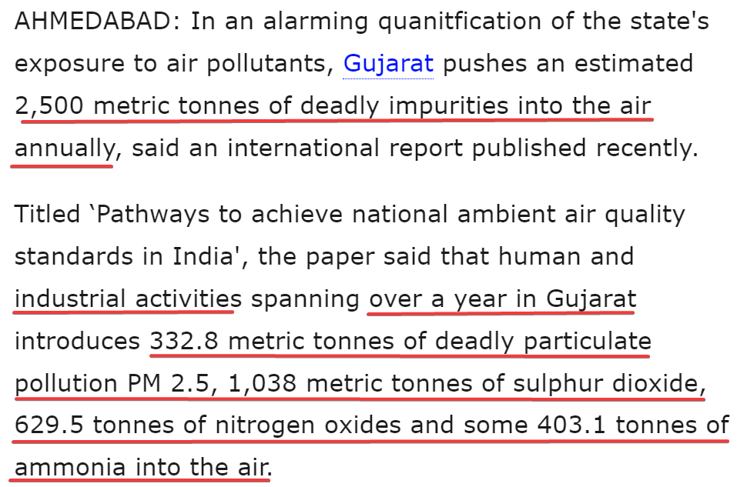
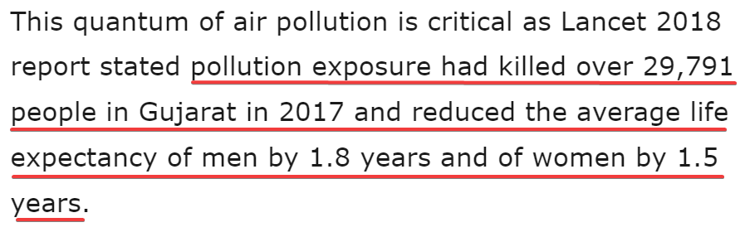
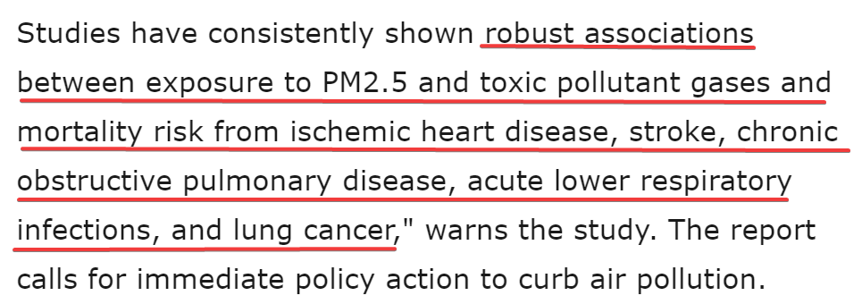
India’s Air Quality Problem

Slide 7
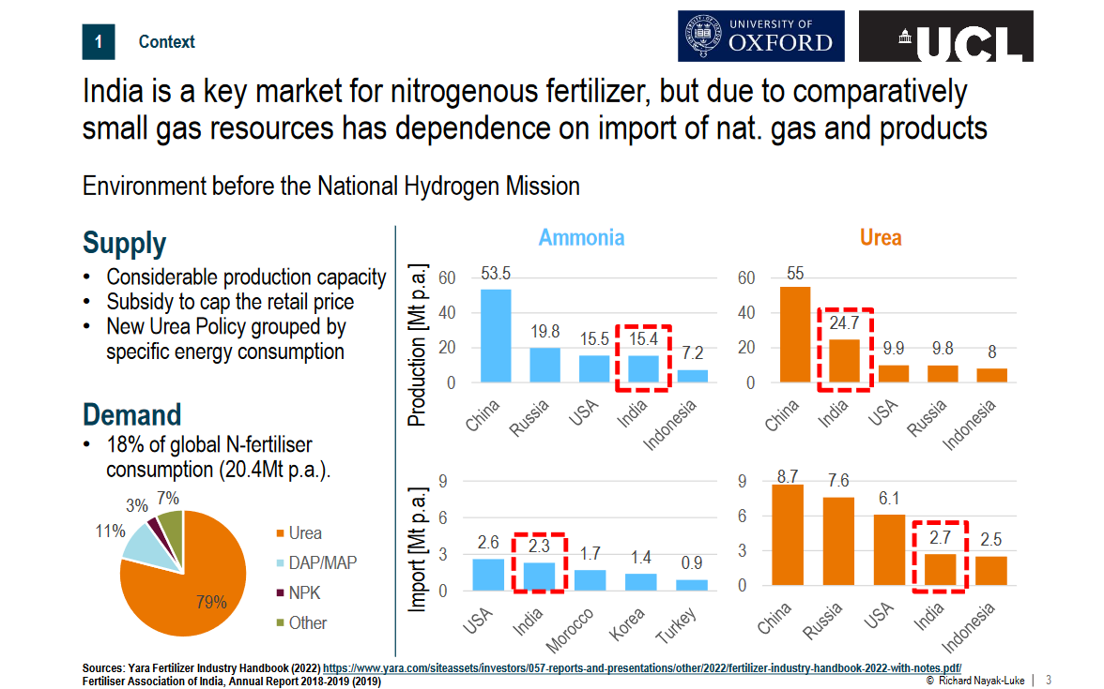

Slide 8
India’s Ammonia Production
**All competitors produce ammonia by Haber-Bosch with coal or natural gas as hydrogen feedstock and energy source
Indian Farmers Fertiliser Cooperative Limited:
Production: Fertilizers (including ammonia-based fertilizers), agricultural products, and various services for farmers.
Estimated production capacity: 300,000 - 800,000 metric tonnes per year.
National Fertilizers Limited (NFL):
Production: Fertilizers (including ammonia-based fertilizers) and industrial chemicals.
Estimated production capacity: 600,000 - 1,200,000 metric tonnes per year.
Rashtriya Chemicals & Fertilizers (RCF):
Production: Fertilizers, chemicals, and industrial products (including ammonia).
Estimated production capacity: 800,000 - 1,500,000 metric tonnes per year.
Gujarat State Fertilizers & Chemicals Ltd. (GSFC):
Production: Fertilizers, chemicals, and petrochemicals (including ammonia).
Estimated production capacity: 1,000,000 - 2,000,000 metric tonnes per year.

Slide 9
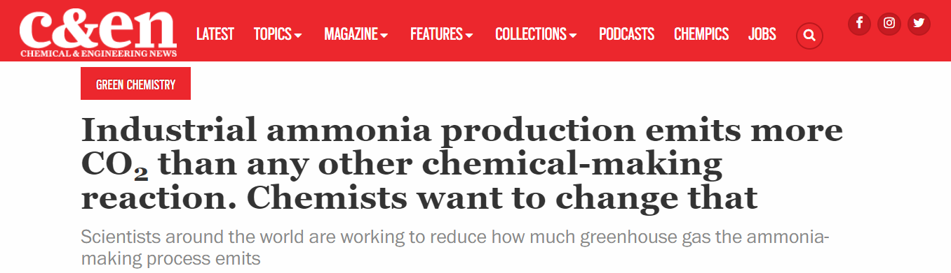

Slide 10
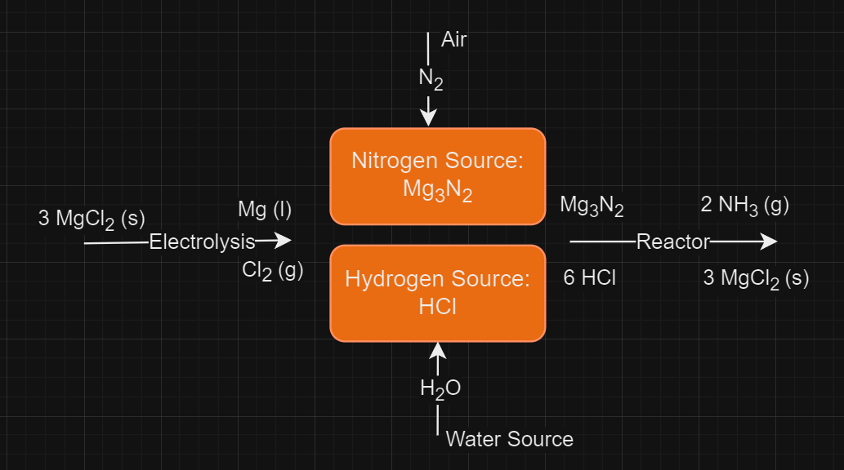
Process Design

Slide 11
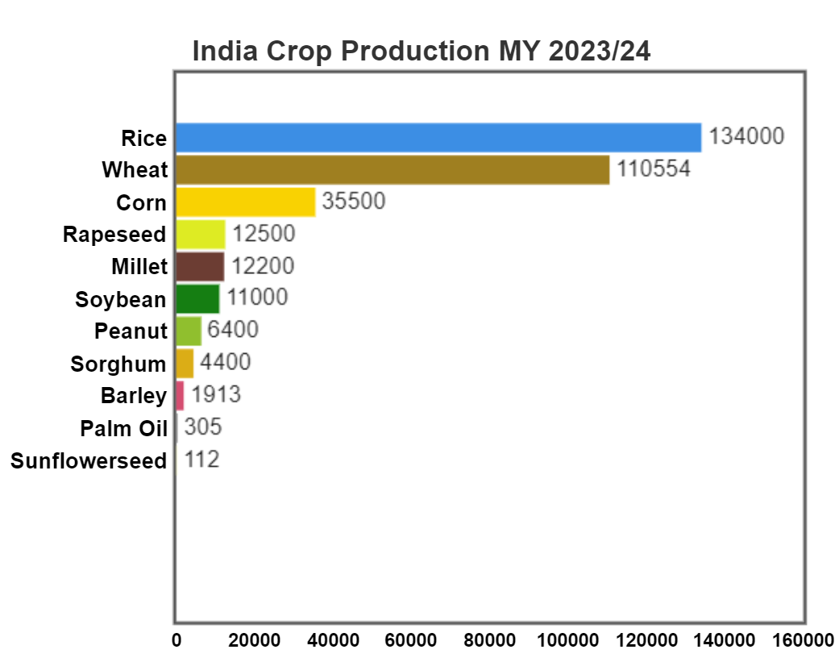

Slide 12
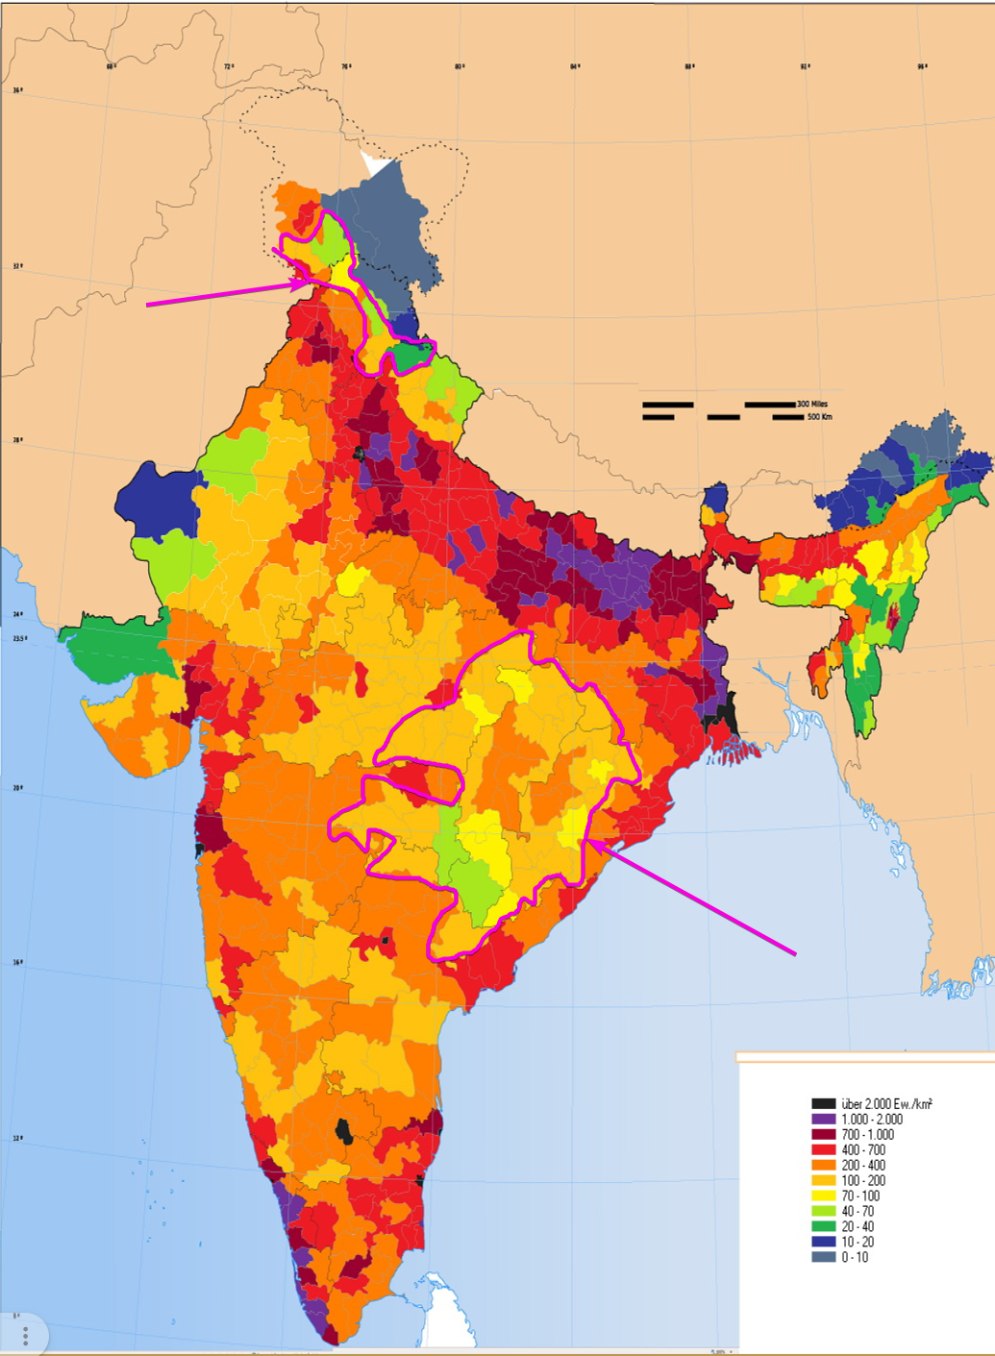
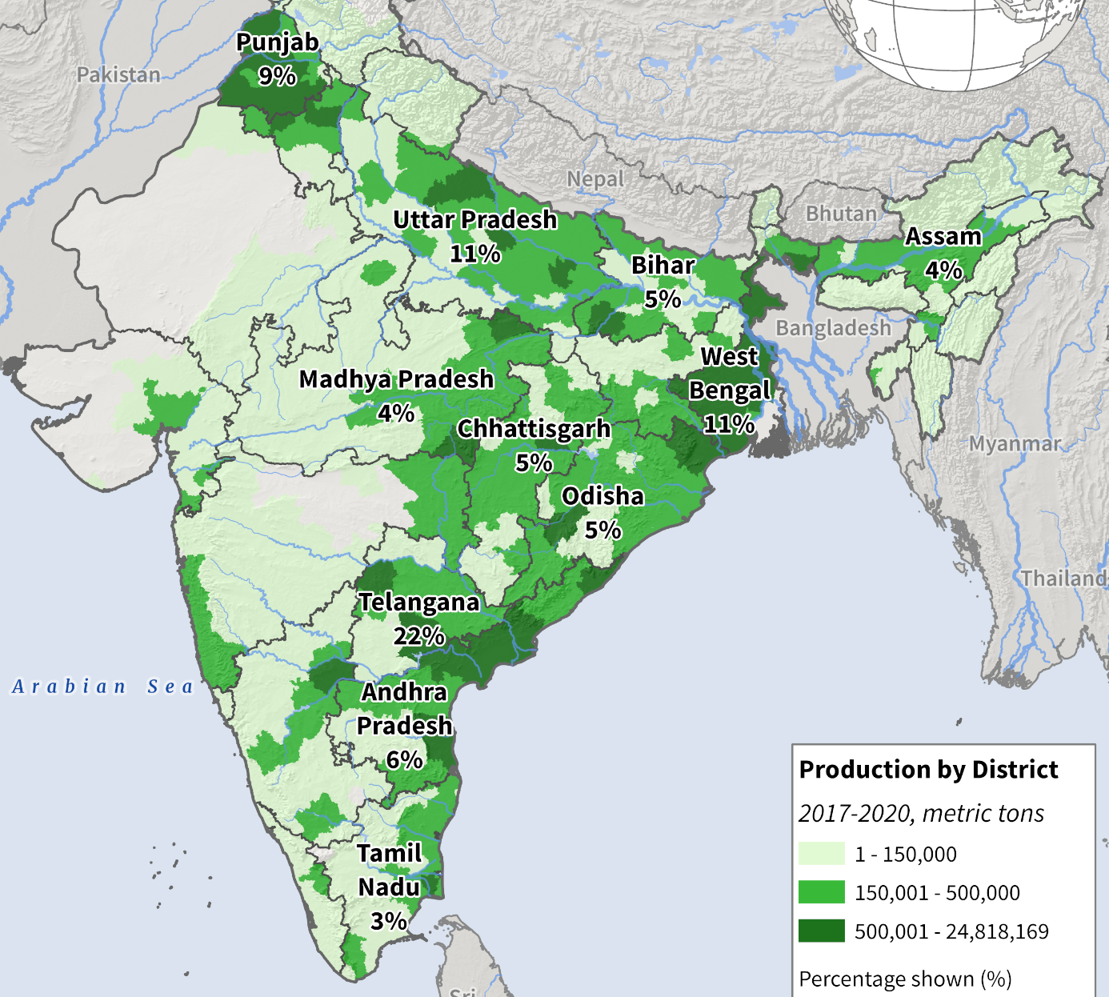
Rice Production

Slide 13
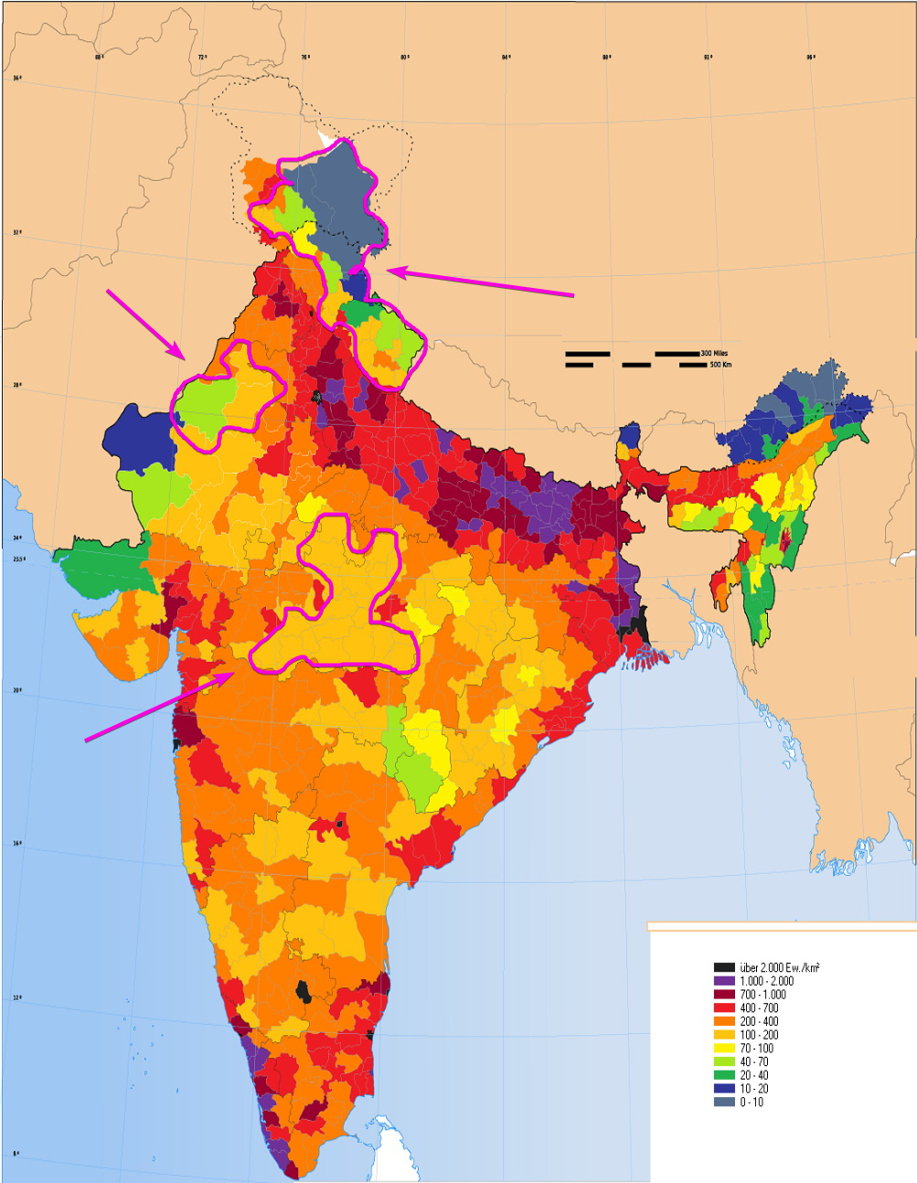
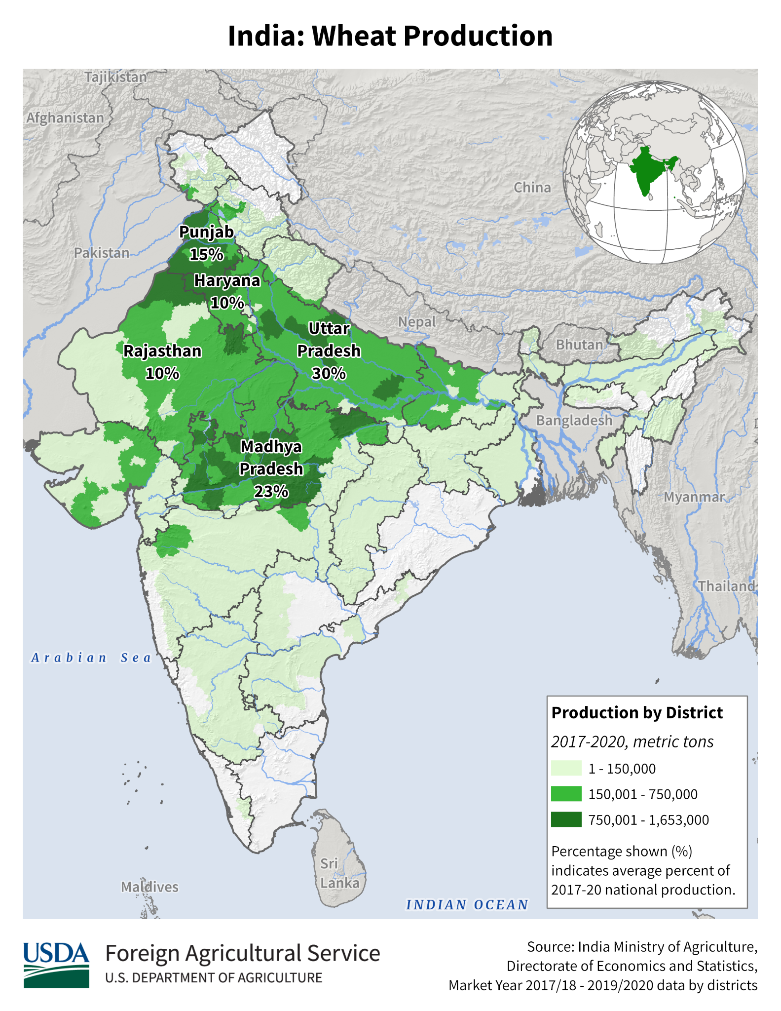
Wheat Production

Slide 14
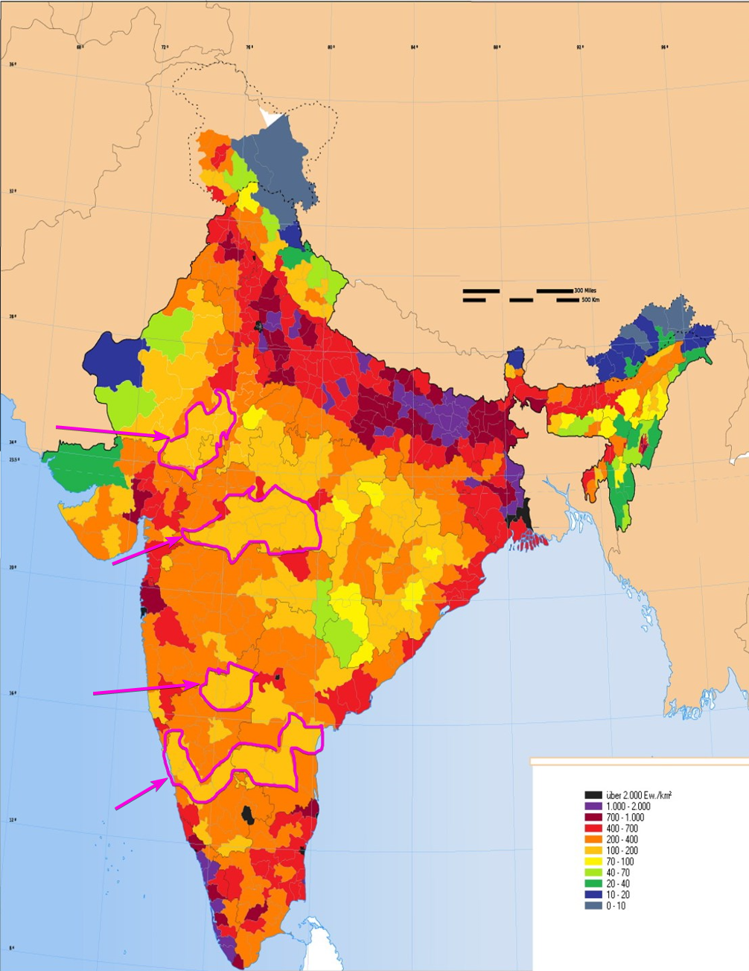
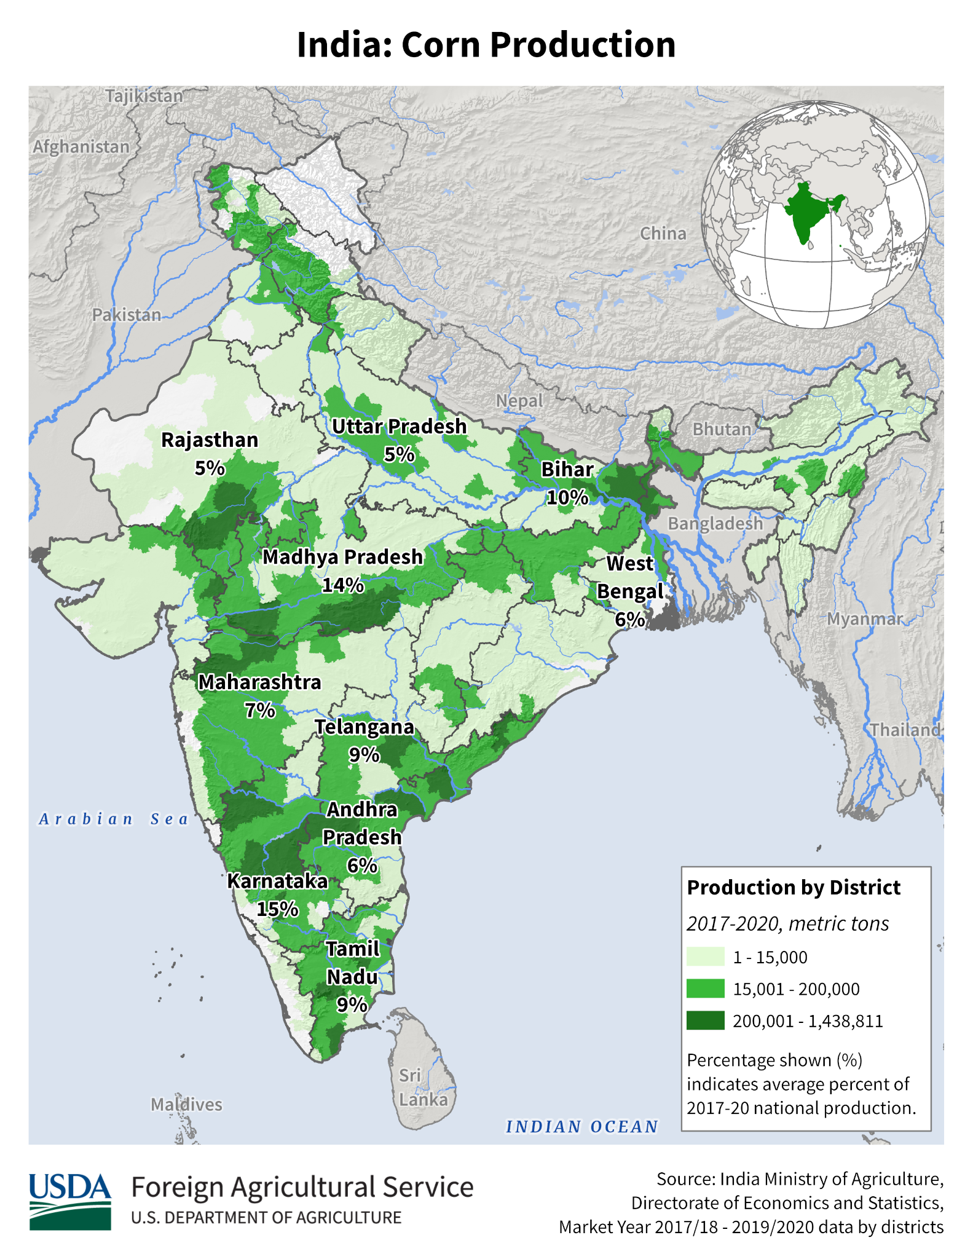
Corn Production

Slide 15
Social & Cultural Impact
2nd Largest Ammonia Importer
Goal to Eliminate Ammonia Imports by 2035
Replace Imports with Locally Produced Green Ammonia
Phase-out high-polluting Haber-Bosch ammonia synthesis with significantly lower-polluting modular electrosynthesis design
With Urea add-on module, the only emission would be oxygen
Improve air quality and reduce emissions
Offer Co-Ops to Engineering Students in Region
Offer Tours to Students and Faculty in Higher Secondary Schools
Operators in India will receive same compensation as operators in United States

Slide 16
Process Safety, Waste, Noise
Comprehensive process safety training for operators
Siphons used for high temperature solid and liquid transport
Pressure and temperature control loops on all reactors
Exothermic reactors have actively-cooled salt-plugs to quench runaway reactions
Process noise minimized by sound enclosures on compressors
Ammonia is stored in underground tanks resistant to natural disasters
Excess ammonia converted to stable and safe fertilizers

Slide 17
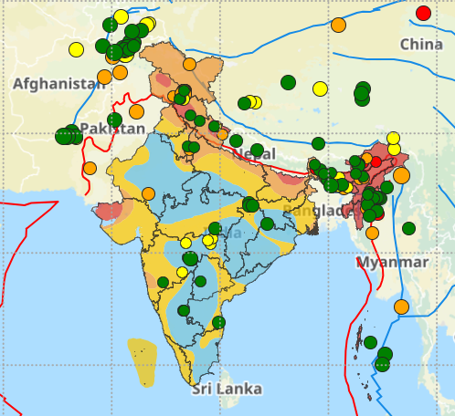
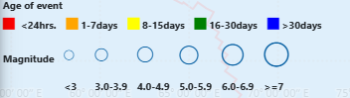
Earthquakes

Slide 18
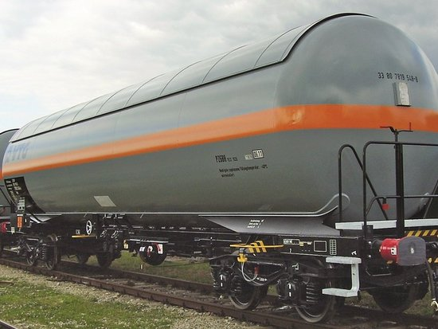
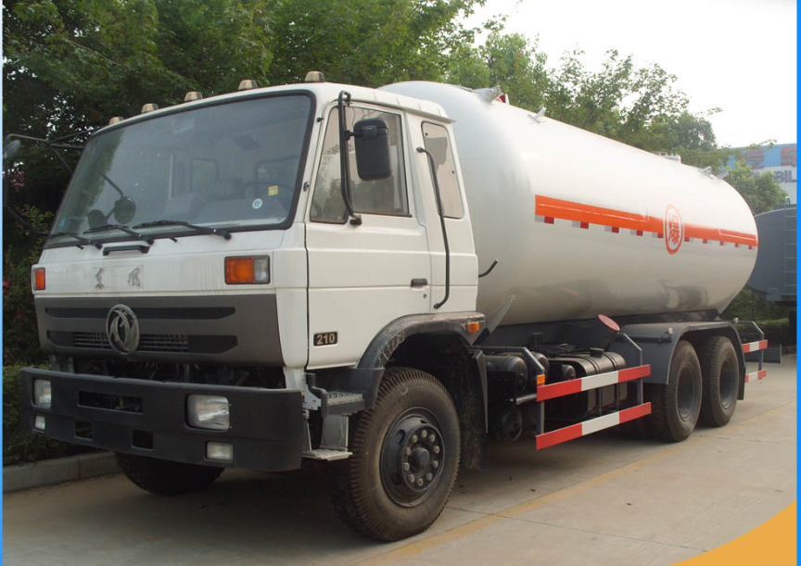
Transport
Trucks to closer regions
Trains to further regions

Slide 19
Questions?

